Slide 1


Intelligent Video Surveillance
End of human monitoring to CCTV

Slide 2
Presented by:
Patel Utsav (19BECE30194)
Patel Vinay (19BECE30569)
Patel Prince (19BECE30556)
Patel Dax (19BECE30509)
Group : G-13

Slide 3
What does “Intelligent Video Surveillance” means ?
The proposal is to use the concept of ‘artificial intelligence and digital image processing’ in surveillance system to detect crime or crime related events , threats and notify officials accordingly.
The system could monitor the visual and audio data obtained from the security cameras in-built with microphone and process them to detect crime or crime related events and notify the officials accordingly.

Slide 4
Regarding network architecture used
We have generally seen deep neural networks for computer vision, image classification, and object detection tasks. In this project, we have to extend deep neural networks to 3-dimensional for learning spatio-temporal features of the video feed.
For this video surveillance project, we will introduce a spatio temporal autoencoder, which is based on a 3D convolution network. The encoder part extracts the spatial and temporal information, and then the decoder reconstructs the frames. The abnormal events are identified by computing the reconstruction loss using Euclidean distance between original and reconstructed batch.

Slide 5
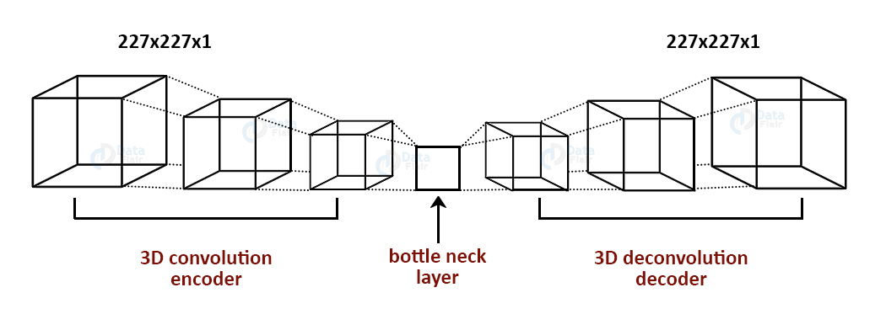
Architecture overview

Slide 6
Dataset used
There are main two dataset used for training of model
CUHK Avenue Dataset
UCSD Pedestrian Dataset

Slide 7
CUHK Avenue Dataset
This dataset contains 16 training and 21 testing video clips. The video contains 30652 frames in total.
The training videos contain video with normal situations. The testing videos contain videos with both standard and abnormal events.
Dataset Link : CUHK Dataset

Slide 8
UCSD Pedestrian Dataset
This dataset contains videos with pedestrians. It includes groups of people walking towards, away, and parallel to the camera. The abnormal event includes:
Non-Pedestrian entities
Anomalous pedestrian motion patterns
Dataset Link : UCSD Dataset

Slide 9
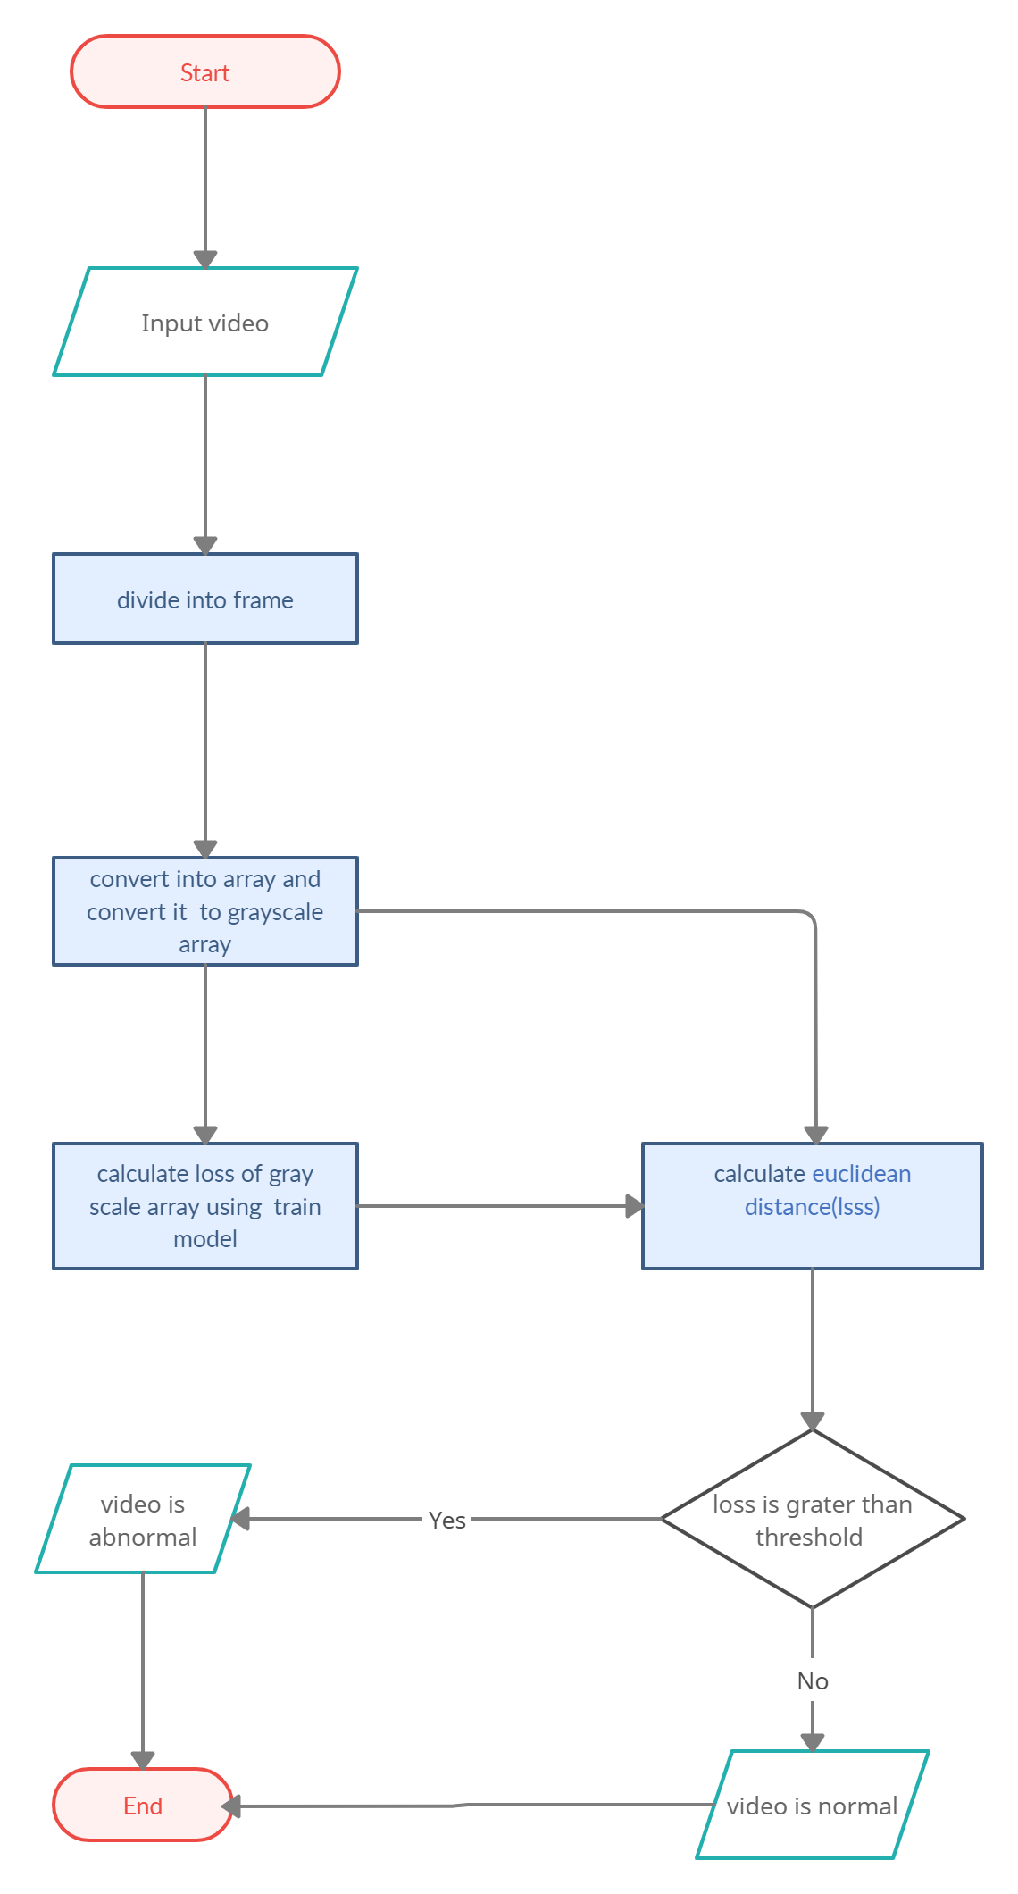
Flow diagram

Slide 10
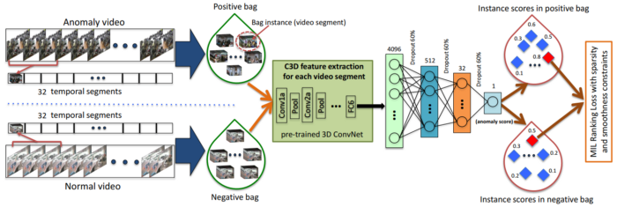
Flow diagram

Slide 11
Technologies used in Intelligent video surveillance
Tensorflow
Keras
openCV
Object detection
Object colour classification
Abnormal event definition and classification
Color image to gray

Slide 12
What is TensorFlow ?
TensorFlow is an open-source library and end to end platform for Deep learning and Machine learning.
Developed by Google Brain Team and released in November 2015.
TensorFlow ease the process of acquiring data, training models, solving predictions and refining future results.
TensorFlow is a software library for numerical computation and large scale machine learning.
TensorFlow is use to classify the image & detect object in machine learning.
Tensors is a vector or matrix of n dimensions which is standard way of representing data in deep learning.

Slide 13
What is Keras ?
Keras is a open-source and high-level deep learning API written in Python for neural networks.
It supports multiple backend neural network computations like Theano and TensorFlow and makes implementing neural network easily.
It runs in CPU and GPU both.
It supports almost all models of neural network.

Slide 14
What is OpenCV ?
OpenCV is a library of programming functions mainly aimed at real-time computer vision.
Originally developed by Intel.
The library is cross-platform and free for use under the open-source BSD license.
OpenCV is written in C++ and its primary interface is in C++.
There are bindings in Python, Java and MATLAB/OCTAVE.

Slide 15
Use of TensorFlow, keras and OpenCV
Modern video cameras capture a wide range of information about people, vehicles, events etc.
The type of information captured is dependent upon a number of parameters like camera type, camera angle, field of view, day or night, weather of area etc.
To automatically detect each type of information requires specialized sets of algorithms used which are predefined in TensorFlow, Keras and OpenCV like frameworks.

Slide 16
Object detection
One of the core capabilities of intelligent video surveillance system is that the ability to detect and track moving objects.
Object detection is a technology that include computer vision and image processing use to detect images and videos.
Object detection algorithms are typically statistical learning algorithms that dynamically learn the scene background model and use the reference model to determine which parts of scene correspond to moving objects.
Ex. Self driving car, Distance between cars and moving object.

Slide 17
Object color classification
Object classification algorithms classify objects into different classes for example, People, Vehicles, Animals etc. and use training data and calibration schemes.
Color classification classifies the dominant color of the object into one of the standard color.
Like : red, green, blue, yellow, black, white.

Slide 18
Abnormal event definition and classification
Typically intelligent video surveillance system support a variety of user defined behaviour detection capabilities such as detecting motion within a defined zone, detecting objects that cross a user defined virtual boundary and detecting objects that are abandoned (Like: gunes, sharp objects etc.).
GUI(graphical user interface) tools are used to defined zones of interest, object size and other parameters needed to define the behaviour.

Slide 19
Implications of Intelligent Video Surveillance
Intelligent video surveillance is a technology that has many different applications and potentially has significant implications to surveillance application, namely security and privacy.
Security implications : clearly, the ability to provide real time alerts, capture high value video and provide sophisticated forensic video retrieval has the potential to enhance security in various public and private domains.

Slide 20
Future Scope
This technology can be combined with CCTV camera in future to eliminate all human failures.
This system can be install to banking, railways, factories, dock yards, airports etc to enhance its security.
This system can be coupled with police stations to directly report nearest station to immediately counter any thef’s.
In future nearest each place will be having CCTV camera so to counter unusual activity it can be use and also for security agency it will help to keep cities secure.
In case of medical emergency it can be also used to send alert to hospital.

Slide 21
Summary
we train an autoencoder for abnormal event detection. We train the autoencoder on normal videos. We identify the abnormal events based on the euclidean distance of the custom video feed and the frames predicted by the autoencoder.
We set a threshold value for abnormal events to be 0.00064.

Slide 22
References
https://data-flair.training/blogs/
https://towardsdatascience.com/tagged/machine-learning-projects
https://www.tensorflow.org/api_docs/python/tf
https://docs.opencv.org/4.x/d4/db1/tutorial_documentation.html
https://www.tensorflow.org/guide/keras/rnn
https://keras.io/api

Slide 23
Thank you !!

